Slide 1
Pattern recognition – computer vision analysis
Problem : Predict the class of flower based on available attributes
Tools : R programming
Group 1 -
Shubham Maheshwari, Ravinder Saluja, Upasana Washimkar, Anuj Sahay

Slide 2
DATA ANALYSIS PROCESS
Data collection and preparation a) Collect data b) Set up structure of data c) Enter data d) Split the data into train and test data
Exploration of data a) Levels of the Class b) Class distribution c) Plot graphs
Analysis a) Explore relation between variables b) Compare the algorithm c) Check accuracy

Slide 3
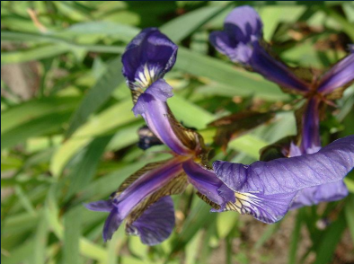
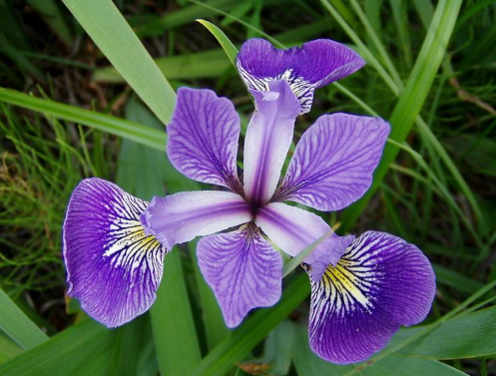
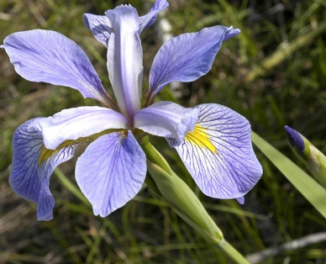
Iris setosa
Iris versicolor
Iris virginica

Slide 4
Iris flower data-set
Also called Fisher’s Iris data set or Anderson’s Iris data set
Collected by Edgar Anderson and Gaspé Peninsula
To quantify the morphologic variation of Iris flowers of three related species

Slide 5
Exploration of Data
Descriptive Statistics
Graphs

Slide 6
Some basic functions in R to examine Iris data:-
Class Distribution
percentage <- prop.table(table(dataset$Species)) * 100
cbind(freq=table(dataset$species), percentage=percentage)
Levels of the Class
levels(dataset$Species)
List types for each attributes
sapply(dataset, class)

Slide 7
Summarize >summary(iris)
Mean
Standard deviation
Minimum
Maximum
Skewness (symmetry)
Kurtosis (peakness)
Numerical Descriptive :-

Slide 8
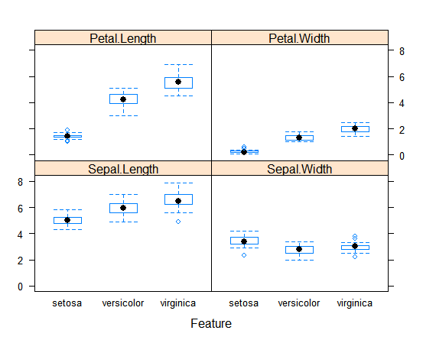
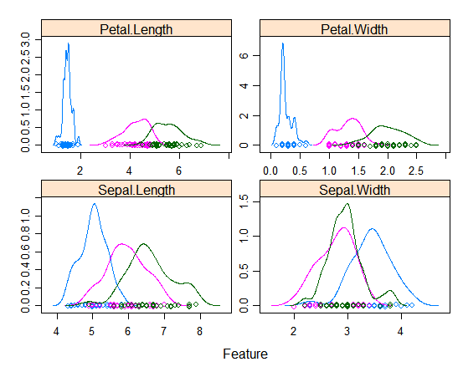
Plots >plot(iris) (Feature Plot)

Slide 9
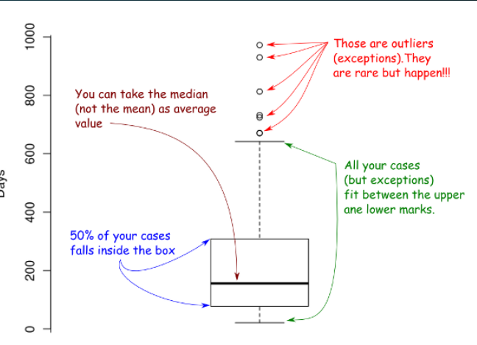
Box Plot >boxplot(iris$Petal.Length~ iris$Species)

Slide 10
Build a statistical model!
Data Mining:
Classification
Regression
Deviation detection

Slide 11
Clustering Principle : based on measure of distance.
Clustering is an unsupervised learning technique. It is the task of grouping together a set of objects in a way that objects in the same cluster are more similar to each other than to objects in other clusters. Similarity is an amount that reflects the strength of relationship between two data objects. Clustering is mainly used for exploratory data mining. It is used in many fields such as machine learning, pattern recognition, image analysis, information retrieval, bio-informatics, data compression, and computer graphics.

Slide 12
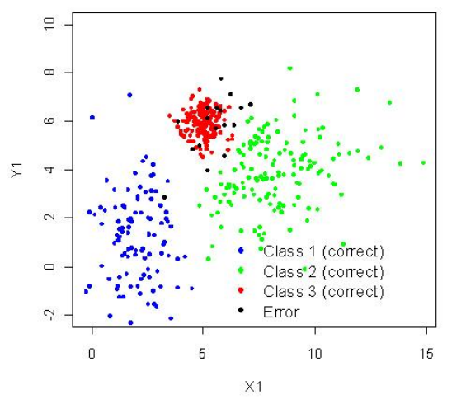
Classification

Slide 13
Analysis
Explore relationships among variables
Correlation
Regression
Logical Regression
Factor analysis

Slide 14
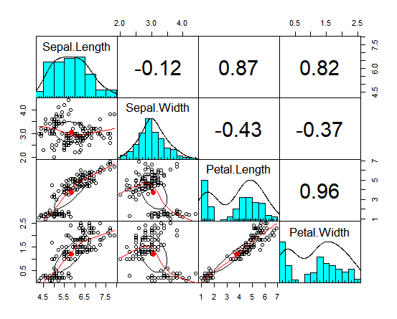
Correlation

Slide 15
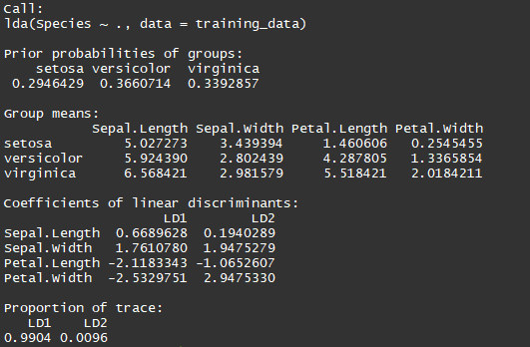
Linear Regression Summary

Slide 16
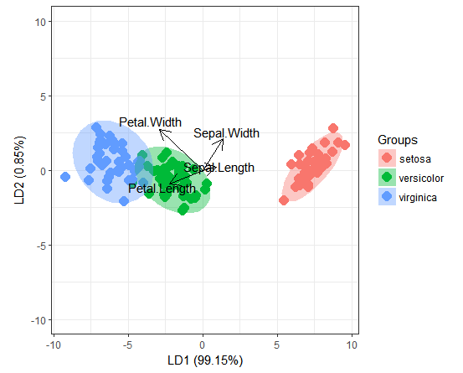
Bi-Plot

Slide 17
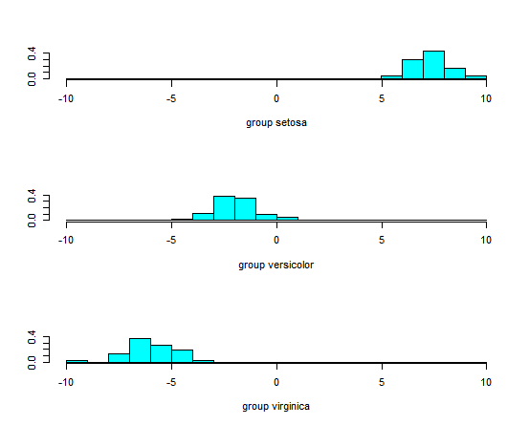
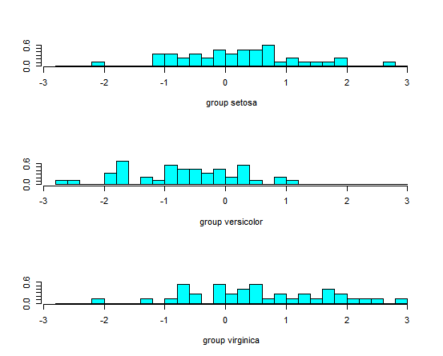
Histogram
Histogram1 is based on LD1 LD1 = 0.9904
Histogram2 is based on LD2 LD2=0.0096

Slide 18
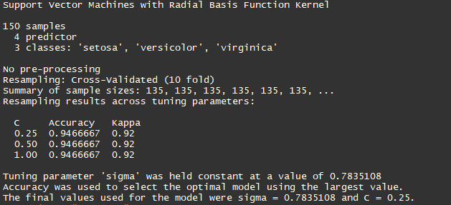
Analysis by using Support Vector Machine(SVM)

Slide 19
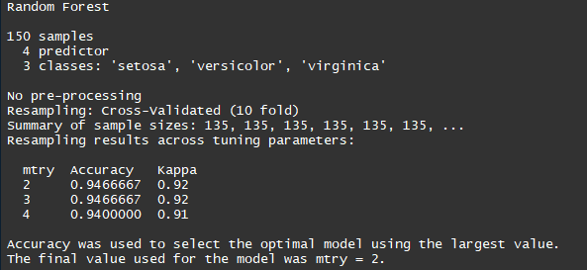
Analysis by Using Random Forest

Slide 20
THANK YOU

